Slide 1
(LM Brady and B Graham, 2021)

Slide 2
These slides are examples but format, layout etc can be amended to suit an individual service/project/group, eg add more photos or colour or other design features etc as needed
Words that might need to be explained further and/or added to a glossary of research terms are indicated in bold

Slide 3
Session 1:
What is research or evaluation?

Slide 4
A process of finding out abut something in in a systematic way
Research can be used to create new knowledge/ information about an issue or group of people
And/or to find out more about an issue, or group of people

Slide 5
Evaluation uses research methods and approaches to find out how well a service or project is working and meeting the needs of those who use it
Evaluation can also look back over a project and help assess how well it met its original targets and aims
It can help change things that don’t work or help make
improvements and can help in planning future projects

Slide 6
It can provide evidence about how, when and why services, treatments or other things work well
It can help to change things that don’t work, or make things work better
It can help to better understand the experiences and
needs of groups of people e.g. young people who use a service or have a particular lived experience

Slide 7
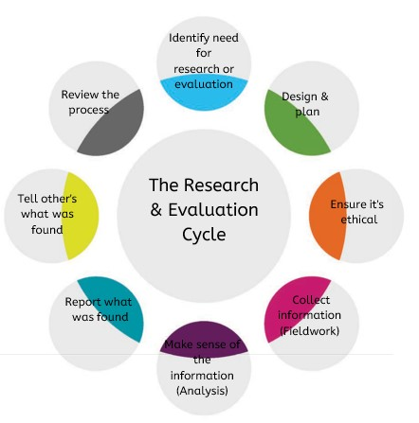

Slide 8
The research / evaluation starts with a clear question or idea to explore
Systematic means choosing methods which help answer the research questions and gather information (‘data’), in a logical and consistent way (e.g. each person is asked the same questions and you record how the research was done)
It is important that research is as unbiased (fair) as
possible - for example not asking ‘leading’ questions or having an unrepresentative sample

Slide 9
Session 2:
Designing the research / evaluation

Slide 10
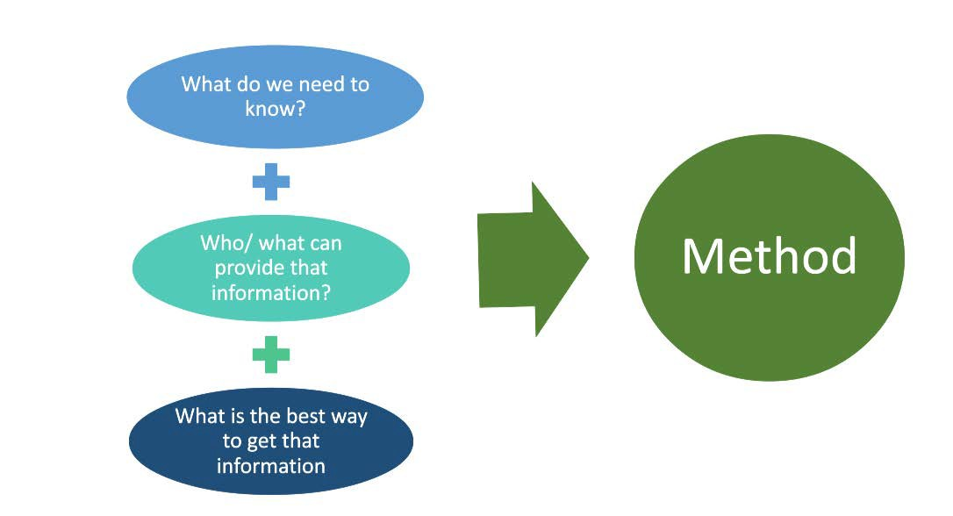

Slide 11
In most projects it won’t be necessary, or possible, to get data from all possible participants (e.g. everyone who uses a service/lives in a certain area)
Each research project has to decide whose information or opinions to gather and how many
This is called ‘sampling’

Slide 12
Decide:
The numbers you need/would like How much data you are realistically able to collect and analyse
Range (e.g. ages, use of service) and
sub-groups to include (sex/gender, ethnic group etc)
How to engage people whose views
are less often heard?

Slide 13
Answers in numbers and statistics (quantities) eg: How many people did X, or Y? Can get views from and compare lots of people, relatively quickly and cheaply
Surveys or questionnaires can be filled in online/by phone/ on paper; alone or with help They mostly use closed questions, which give set choices such as:
Do you like chocolate? Yes/ No
And/ or scales, eg: How much do you like chocolate? A lot A little Not at all
Can include some open questions, eg: ‘Can you give an example?’

Slide 14
Find out what people think and why on their own terms
People use their own words, give their own perspectives to describe, explain and provide a deeper understanding
One-to-one interviews, or focus / discussion groups Mostly ask open questions, such as:
Can you tell me what happened? How do you feel about ….?
Tell me more about ….?
What improvements would you like to see?
To be systematic, start by asking everyone mostly the same questions to help compare answers
Answers - ‘the data’ - are in words

Slide 15
Open
How do you feel about X? What do you think about Y? Tell me about … ?
What happened?
Follow-up questions:
Why?
Could you tell me more about … ? How did that make you feel?
Closed
Give set choices only: such as ‘Yes’/’No’
Did you enjoy that? When did that happen? Who was there?
Where did that happen? What age were you when..?

Slide 16
Open
People have more opportunity to share their views and experiences in their own words and let you know what’s most important to them
You don’t have to anticipate/ guess all the potential issues or answers in advance, and can follow things up if you want to know more
Closed
Easier to count and analyse Easier for large numbers Good starting point for other, more open, questions
Tip: You can usually mix open & closed questions

Slide 17
You can start with a closed question and follow up with an open question
Keep questions short and clear – just one question at a time
Use language and words the other person will easily understand Think of prompts / pictures that might help
Avoid suggesting that there is a right answer (bias)
The people you are asking need to know the answer, or had the relevant experience and be able to remember back far enough (eg you would not ask a 7 year old about something that happened 4 years ago)
Avoid upsetting topics - unless they are really essential (and think about how you will make this safe and support the person)
Don’t ask too many questions – work out which are most important You can only get useful answers if you ask the right questions!

Slide 18
Session 2: Creative methods ideas

Slide 19
Enjoyable
Reduces stress, anxiety
Suits all ages and abilities, interests, setting Good for getting conversations going
Makes it easier to start to talk about & explore topics and discuss sensitive topics Useful where language is limited
Most games or art activities can be adapted
- create your own
The conversation and what the person says is usually the data (not the art)

Slide 20
Art
Poetry, song writing Drama/ acting/ mine Diaries
Blogs Photography/ film
Adapt any game, current popular TV show Use common toys/ games, such as lego, jenga
Make up fun ways to vote or rank e.g. using stickers, using their own body

Slide 21
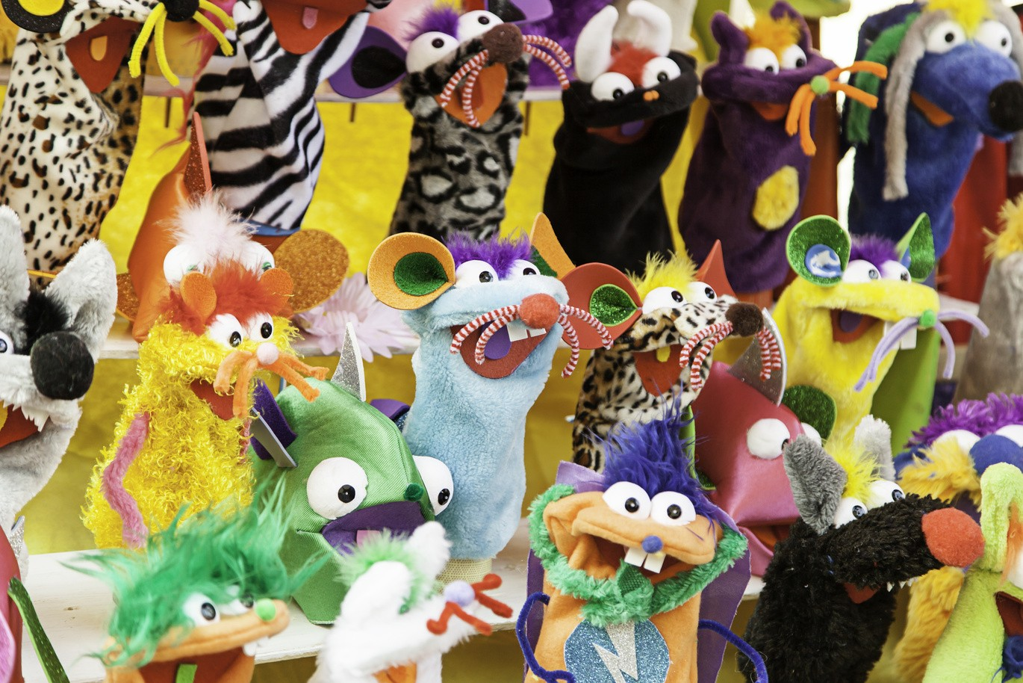

Slide 22
Diary
Mapping
Writing songs/poetry
Scrap booking
Young inspector
Photography

Slide 23
Draw a figure or draw around someone in the group
Add post-its to give views on e.g. The head: thoughts, ideas, plans,.. The heart – feelings & emotions,..
The hands - practical issues, support, care,… The feet: actions they take/ could take, ….

Slide 24
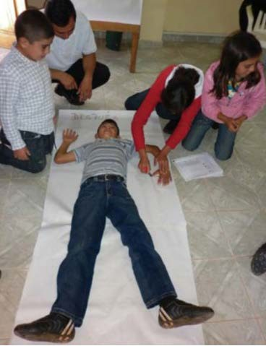
“Dividing the body with a vertical line from top to bottom to signify the situation ‘before’ and ‘after’ our involvement in children’s parliaments, we were able to notice the various improvements …with regard to our thinking, outlook, listening, communication, health, activities, reach, etc., that occurred.”
From Save the Children, A Toolkit for Monitoring and Evaluating Children’s Participation. Booklet 6, p10

Slide 25
Can use smart phones
Need to ask someone’s consent to take and use a photo of them
Risk of taking too many & they may be a hard to analyse
Photos don’t necessarily talk for themselves
Seek professional help to edit a short film
Example: Our Rights Our Voice (health rights for disabled children and young people) www.youtube/qnqTJ8-N3Q0

Slide 26
Helps tease out an issue Explore range of feelings and reactions to an issue
Develop topics
Can be used to share research findings Generate recommendations

Slide 27
Draw around someone in the group
Draw thought bubbles: What are they thinking about? What questions might they have?
Heart: how are they feeling? Good/bad
Eyes: what have they noticed? Is anything different?
Smile: what makes them happy? What would help make them happy?
Hand: who might support them? Help them keep and feel safe?
Rubbish bin : What bits of life would they like to chuck in the bin
From Barnardo’s project gathering children’s reactions to parents being in prison

Slide 28
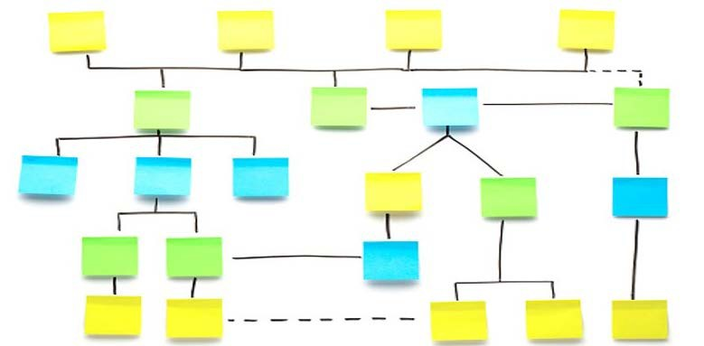
Many ways with post-its & stickers

Slide 29
Session 3: Ethics

Slide 30
Ethics = making sure the research or evaluation does not cause anyone any physical, emotional, or other type of harm.
This can involve someone checking your research plans before you start the project to make sure it is safe – for example a Research Ethics Committee.
All research needs to be ethical, but the details may be different from project to project.
You need to keep ethics in mind all the way through your project, not just at the start.
If you’re not sure about something, discuss with others and / or get advice

Slide 31
Ethics = making sure the research or evaluation does not cause anyone any physical, emotional, or other type of harm.
This can involve someone checking your research plans before you start the project to make sure it is safe – for example a Research Ethics Committee.
All research needs to be ethical, but the details may be different from project to project.
You need to keep ethics in mind all the way through your project, not just at the start.
If you’re not sure about something, discuss with others and / or get advice

Slide 32
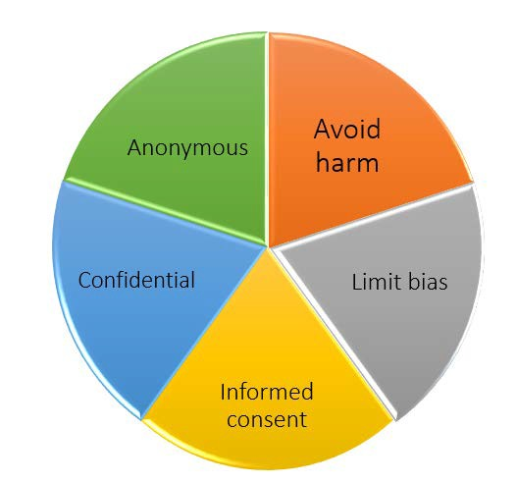

Slide 33
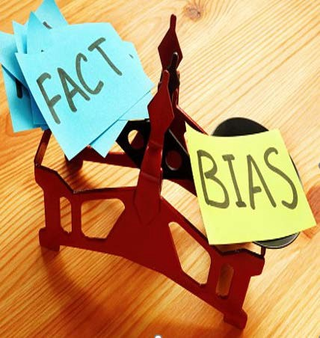
Bias is hard to avoid completely. Try to think about:
Whose views you gather What questions you ask How each question is asked
(words, emphasis, tone of voice ...) What you report and how

Slide 34
Explanations about the research need to be very clear
Each person needs to understand what the research is for, who is doing it, what will happen to the information they give …
You usually need to get a parent’s for carer’s permission for anyone under 16
Taking part, or not, is a choice: someone can agree at first, then change their mind, or not answer a question, or need a break and can stop when they want
Consent is ‘continuous’- you need to keep checking someone is happy to continue
Usually people are asked to sign a consent form

Slide 35
I understand why and how this research is being done.
I understand how the researchers will use the information I give them
I know I can choose to not answer a question if I don’t want to.I know I can stop taking part whenever I want.
I agree to take part in this research.
I, the undersigned, hereby voluntarily consent to articulate all my deliberations relevant to this research study. I comprehend the methodology and how my data may be aggregated and used by the researchers as they think fit.
Signed Date
Signed Date

Slide 36
Only collect information essential to this research/ evaluation Store & handle information securely
Remove names from surveys, interview texts or recordings ASAP Use a code, e.g. letters or numbers instead of names
Don’t share what people tell you (unless you are worried about their safety)
Follow the processes agreed for the project

Slide 37
How easy would it be to find out In comparison to: who this was?
‘Young people said it could be very difficult to attend regular appointments at their diabetes clinics, because of limited public transport and that staff needed to be more welcoming’
‘A Year 8 girl in Hanway Academy School, Somerstown, said that her nearest diabetes clinic, which she must attend each week was too far from the train station and the staff were not that helpful’

Slide 38
Can you think of some ways that this project could cause someone harm or distress?
Can you think of ways to make this project safe, enjoyable and rewarding for participants?

Slide 39
Tips when doing interviews and focus groups

Slide 40
Facial expressions – interested, smile, nod, relaxed Open posture – relaxed, shoulders down, sit up straight Face the person, or at an angle - 45%
Eye contact - but not staring Sound encouraging

Slide 41
Introduce yourself and the research – do not presume they have read / been told everything Ask them if they have they any questions before you start, are they happy to be interviewed and be recorded ( if that’s what you are hoping to record them)
Ask the listed questions, but try to let it flow like a conversation Give people time to think before answering
Remind them there are no right or wrong answers Ask them to repeat or explain anything that’s unclear In surveys the ordered and question wording is set.
But in qualitative interviews you can follow their train of thought, but try to make sure the important topics are covered. It can help to say things like: ‘I’d just like to come back to…’ Listen attentively - follow up if necessary & allowed
Record or take notes - as agreed in the project
Stop if someone gets upset or tells you they do not want to answer any more questions
At end thank them for their sharing their views, say what happens next, give any voucher, etc

Slide 42
Focus group – flow and order
Start with warm-ups and ice breakers
Agree ground rules – e.g. what’s said in the room is private; only one person should speak at a time, please respect each other’s views, ….
Keep energy up; change intensity, e.g. with breaks, sit – stand, move about Plan ahead how to deal with any issues which might come up
Keep people on the subject
Ask questions of the whole group, not just to a few people/ the loud ones Encourage everyone to take part: directly ask quiet people what they think Break into sub-groups and mix and match these
You do not need to get agreement on a topic, just the range of views

Slide 43
Start with warm-ups and ice breakers
Agree ground rules – e.g. what’s said in the room is private; only one person should speak at a time, please respect each other’s views, ….
Keep energy up; change intensity, e.g. with breaks, sit – stand, move about Plan ahead how to deal with any issues which might come up
Keep people on the subject
Ask questions of the whole group, not just to a few people/ the loud ones Encourage everyone to take part: directly ask quiet people what they think Break into sub-groups and mix and match these
You do not need to get agreement on a topic, just the range of views

Slide 44
Session 5. Data analysis

Slide 45
‘Analysing data’ means looking closely at the information collected to looks for patterns and see whether it contains evidence which can be used to answer the research or evaluation questions
Data can be numbers (‘quantitative data’) or words (‘qualitative data).

Slide 47
Analysing qualitative data (words, images,…)
How many ways could you sort these?

Slide 48
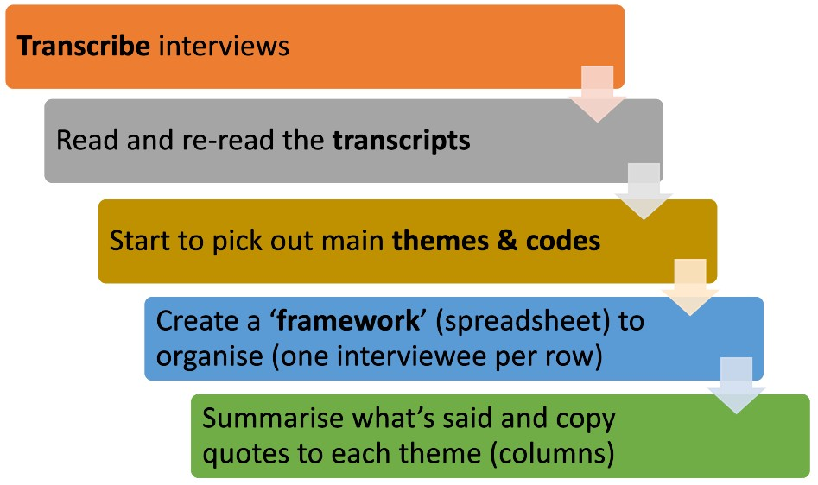

Slide 49
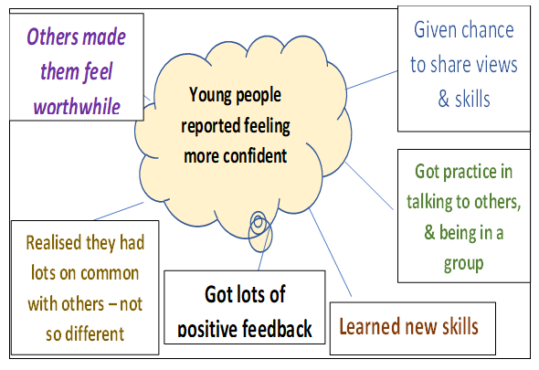
The ideas/ patterns ‘themes’ came from reading the interviews.
These points were all made by the interviewees.
They were not known in advance. Can call this ‘bottom-up’ analysis. Then check if others say the same. Can be added as another theme – in in addition to ones you anticipate

Slide 50
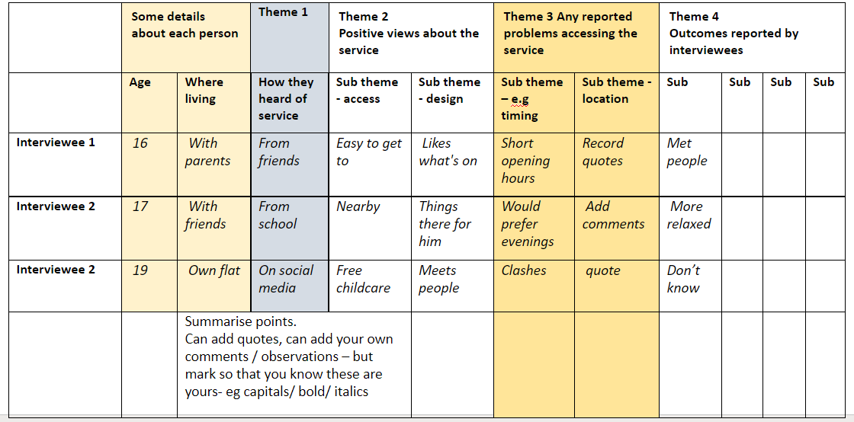

Slide 51
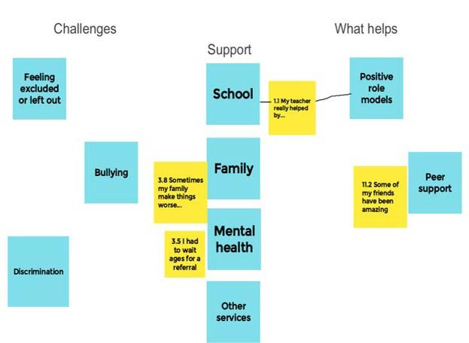
The broad categories (headings - ‘challenges’, ‘support’, ‘what helps’) and themes (on the blue post- its) came from the young and adult researchers.
The yellow post-its are quotes by interviewees. More were added over time

Slide 52
Don’t use numbers (e.g. ‘20 number of people said X’), but you could say something like ‘A common theme was opening times’.
Some points may have only been made by one person but can still be important to include.
Use quotes to illustrate your points and give your interviewees a voice. Keep them short and take out unimportant bits (use dots to show you’ve done this) and anything that might identify someone. Example:
“I’d really like the service to be open at evenings and weekends… as that is when people most need help” (Male service user, 17)

Slide 54
Session 6. Data analysis

Slide 55
Quantitative analysis involves numbers and counting
Think about what is needed to answer your research questions and what can be done with the information you have
Look for patterns e.g. how many people agreed or disagreed with a point; how often one group gave an answer compared to another group (e.g. boys versus girls, or different age groups), how things have changed over time (e.g. at the start and end of a project)
Use Excel, Survey Monkey or Google forms to do basic analysis. If you’re working with researchers they may have special software they can use Think about how to present your data
Tables and charts can help convey key information (but use carefully)

Slide 56
Examples
Numbers of people who took part How often they used a service
Some details about them, e.g. ages, where live, Count the answers to closed questions, e.g. ‘yes’, ‘no’, ‘not sure’
or scales (‘like a little’, ‘like a lot’, ‘don’t like’) Can’t generalise – only applies to this group

Slide 57
Usually you can’t generalise from a small sample, & especially if it was self-selecting.
To be able say the findings apply to everyone you need to start with a ‘statistically representative’ sample and follow other rigorous steps But you can describe the group who answered the questions
This might give valuable ideas of actions or services needed & other information needed and questions to ask

Slide 58
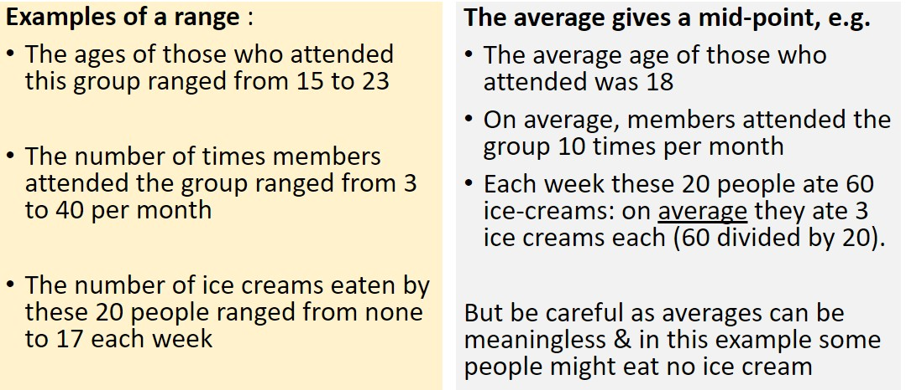

Slide 59
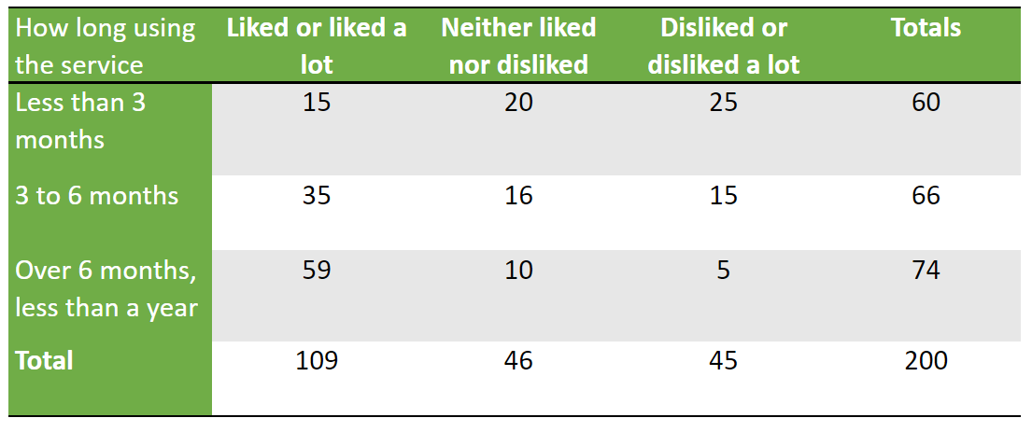

Slide 60
SESSION 7. Sharing and presenting quantitative data

Slide 61
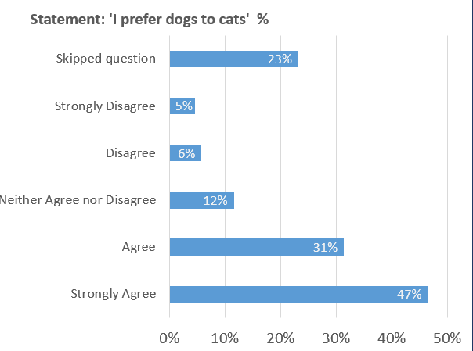
‘A group of 112 people were shown a statement ‘I prefer dogs to cats’, and asked how much they agreed or not. Just under one half (47%) ‘strongly agreed’ with the statement; and just under one-third 31% ‘agreed’ it.
In total over three-quarters (78%) said they preferred dogs to cats.
Roughly one in ten (12%), were undecided.
Over one-fifth (23%), did not answer this question.’

Slide 62
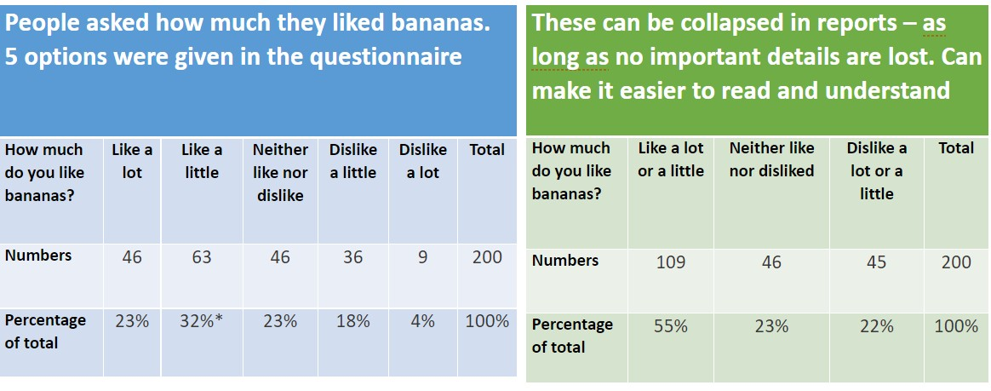

Slide 63
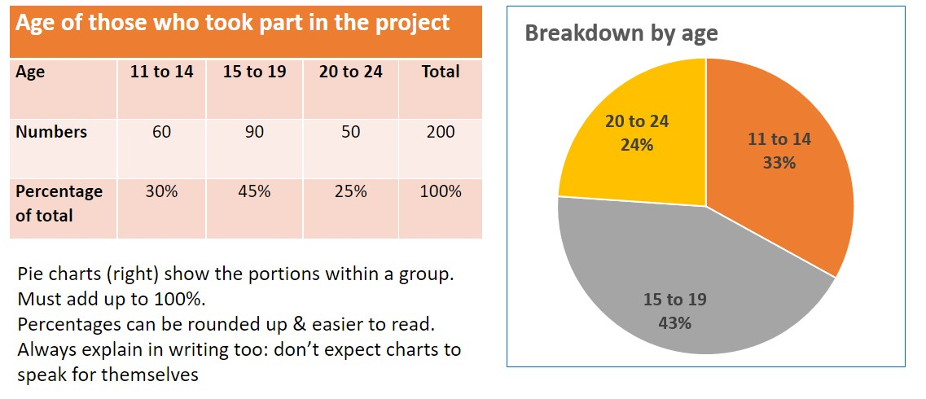

Slide 64
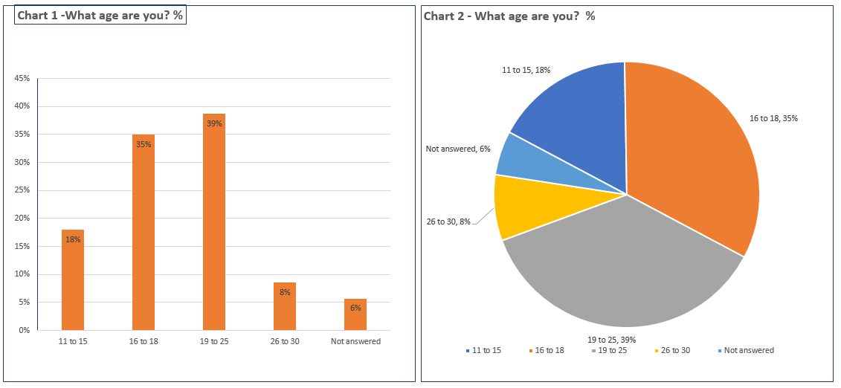

Slide 65
Making generalisations or using percentages if you only have a small sample which doesn’t represent the wider population. E.g. you can report what the young people who used this service said, but that doesn’t mean all young people who use similar services would feel the same.
Saying that your research proves that X, or causes Y, when it might be a mere coincidence
Only reporting the data you agree with, or understand (that’s bias) Presenting data in charts etc in a way that unintentionally risks bias – see next chart on ice cream sales and drowning!

Slide 66
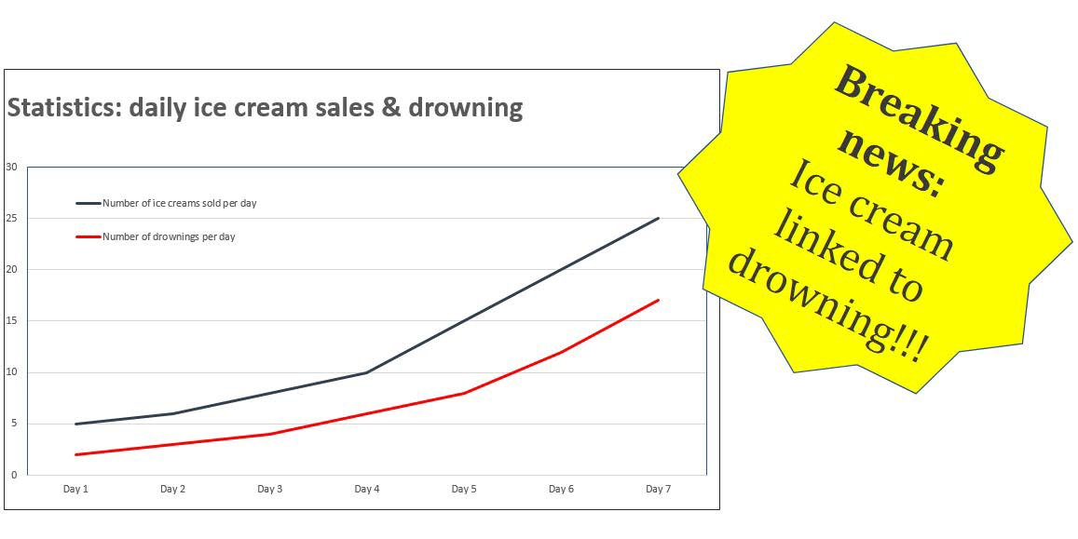

Slide 67
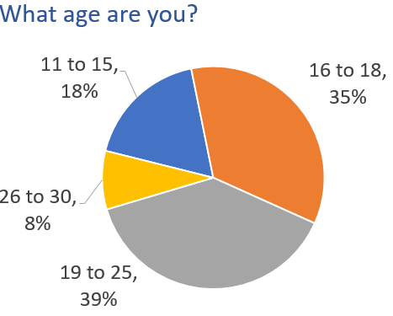
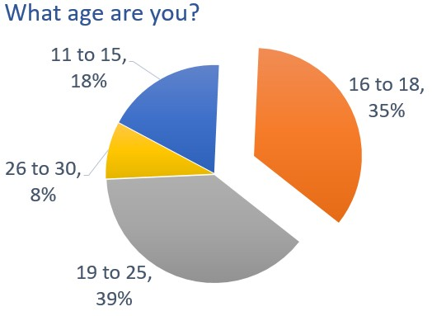

Slide 68
SESSION 8: Reporting what was found

Slide 69
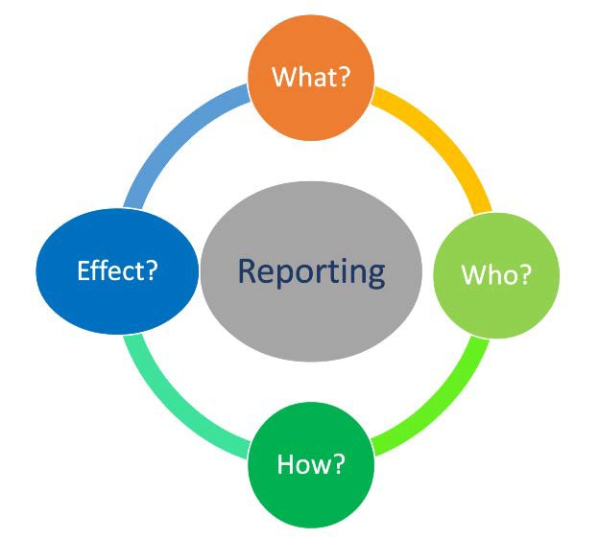

Slide 70
Professionals?
For each:
What would you
like them to do with the new information?
Politicians?
Others?
Young people?

Slide 71
Typical sections
A stand-alone summary
Introduction, explain aims & methods briefly Main findings – often in separate sections Conclusion – the ‘so what? what does this tell us?
Recommendations – from those researched/ the writers
If combining qualitative and quantitative data, give numbers first, then explain them
Quotes are good, but keep them short
Protect anonymity (avoid names or clues to who said what)

Slide 72
Only reporting or over-emphasising the points you agree with Not using data, or views you disagree with
Leaving out bits you don’t understand
Presenting a service you know in a better or worse way, for whatever reason, e.g. to get more funding
Putting a lot of emphasis on what a small sub-group said Mostly using quotes from the most vocal people

