Slide 1
Barnardo’s Annual Report: explaining our impact and our finances in 2022-23
1

Slide 2
Contents
03 Our reach and support
11 How our finances look

Slide 3
Our reach and support
2022-23

Slide 4
Read our annual report and impact report
2%

Slide 5
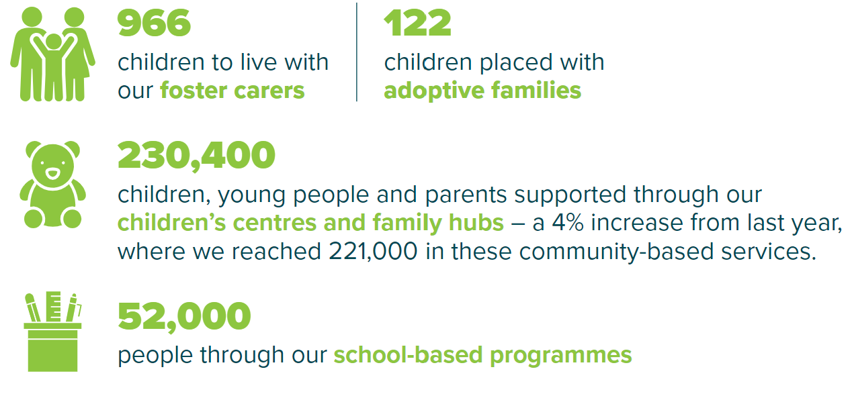
How we made a difference to children’s lives
In 2022-23, together with our partners, we reached 373,200 children, young people, parents and carers. This is 4% more than the year before.
We supported…
2%

Slide 6
How we made a difference to children’s lives
In 2022-23, we supported…
2%

Slide 7
How did we do this?
Our reach was possible due to:
2%

Slide 8
Working with our volunteers
Volunteers are central to what we do at Barnardo’s.
Our work improving the lives of children, young people and families wouldn’t be possible without the dedication, experience and passion of volunteers across the charity.
This year, 16,917 people gave 1.8 million hours of their time to support Barnardo’s.

Slide 9
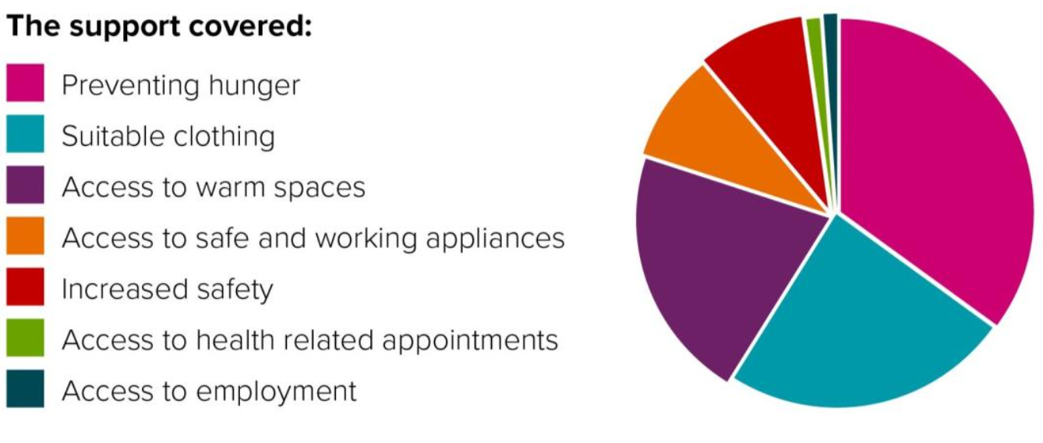
Cost of Living Crisis Fund How we've supported children and families living in poverty
In October 2022, Barnardo's established a fund to help provide immediate support to children and families, accessing our services, who were struggling as a result of the cost of living crisis.
We helped families by preventing hunger, providing suitable clothing, access to warm spaces and more.
Between October 2022 and March 2023, we reached...
over 13,000 people,
including more than 7,000 children and
across over 4,000 households
Learn more on Inside Barnardo's and view our latest policy report, 'No crib for a bed: the impact of the cost of living crisis on bed poverty'

Slide 10
Supporting displaced children and families How we've helped those seeking sanctuary in the UK
We supported 12,000 children, young people, parents and carers who were seeking sanctuary in the UK. This included:
9,730 through our bespoke helpline for families arriving in the UK (available in many languages)
1,319 through our Home Office funded Counter Trafficking Service
822 through our Welcome Service in Scotland
Also supported 449 families in Norther Ireland including 269 families from Syria, and 10 from Afghanistan through our Northern Ireland Refugee Support Service.
These services provide vital support, including help to access basics like food and healthcare; therapeutic mental health support and longer-term assistance with housing, education and employment, so that families can settle in the UK.
A key milestone: Our Warm Welcome report
During Refugee Week in June 2023, we released our Warm Welcome report outlining a blueprint for supporting displaced children seeking protection in the UK at an event in Parliament alongside children with lived experience.

Slide 11
How our finances look
2022-23

Slide 12
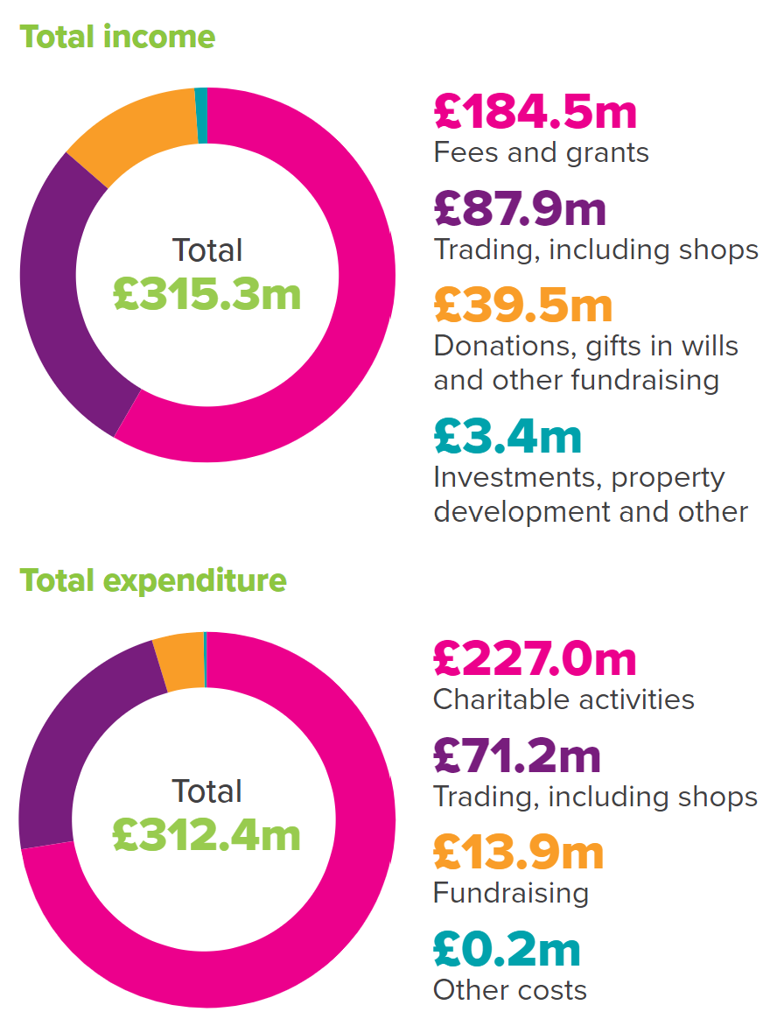
Our income and where it comes from
Our total income for 2022-23 was £315.3 million.
£184.5 million of this came from fees and grants we receive from our partners for our commissioned charitable activities. We work with partners in national and local government and the NHS to deliver vital support for children.
The rest of our income comes from the generous donations and money raised by the public, money made from our local stores and online shop and money from investments, property development and other sources.
2%
40%
£39.5 million
£87.9 million
of our income comes directly from our supporters
was raised through fundraising, donations and gifts in wills
was our retail and trading income with every purchase helping fund vital projects

Slide 13
How we spend our funds
In 2022-23, we spent £227 million on charitable activities, while fundraising and other costs (excluding trading) totalled £14.1 million.
We spent £71.2 million on retail costs.
£13.9 million was spent on generating more funds for the charity.
£0.2 million was spent on other costs such as investment manager costs.
2%

Slide 14
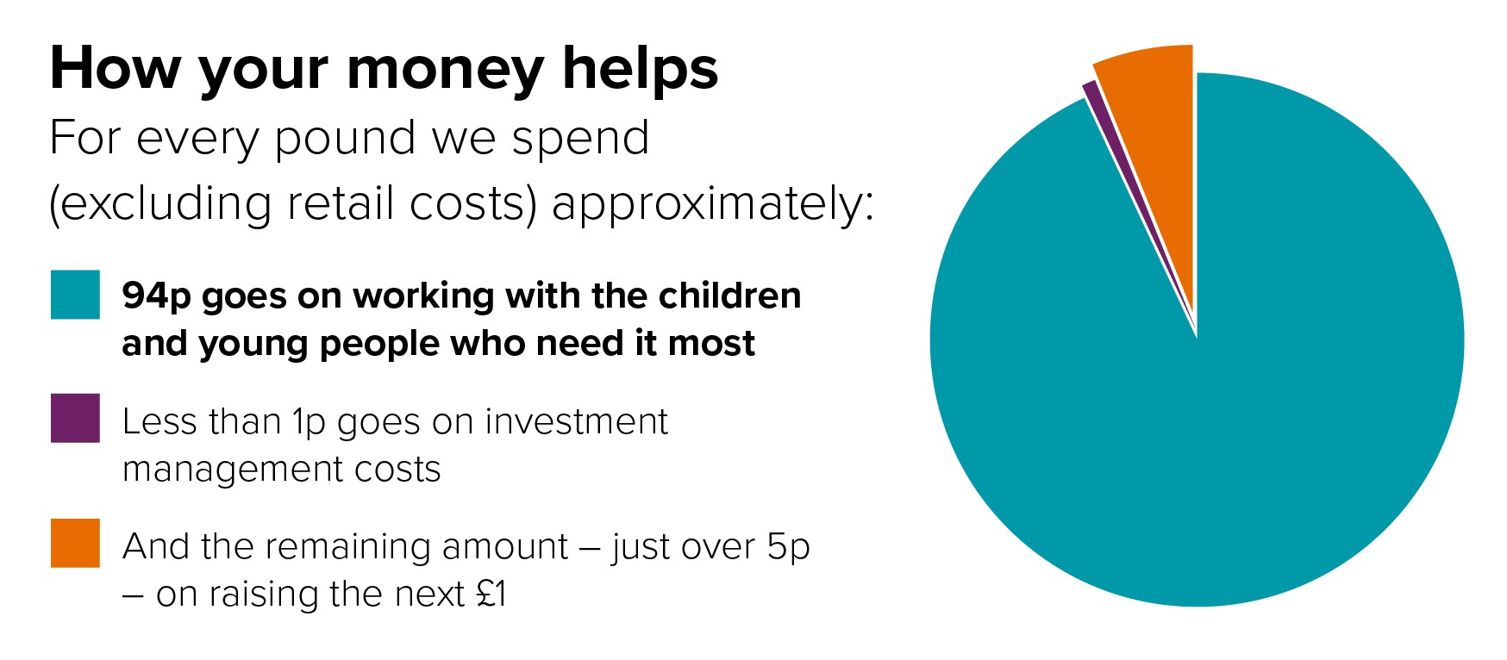
How the money helps
2%

Slide 15
Our income from fundraising
In 2022-23, we fundraised £39.5 million.
Thanks to our incredible supporters, we raised £2.3 million more than last year through donations, gifts in wills and other fundraising. This included fantastic events such as Banking on Barnardo’s and our Firecracker Ball.
Learn more about the different ways you can donate and how it makes a difference to those we support.

Slide 16
Income from our stores and online shop
Our stores, superstores and online shop earned a total of £87.9 million to help fund our work, compared to £77.8m the previous year.
We increased our e-commerce sales to £3.4m and expanded our online shop
We increased new goods sales reaching £7.9m
Every purchase made in our stores helps fund vital projects which support children and families across the UK.

Slide 17
For more information visit Inside Barnardo’s:
- Annual Report
- Impact Report
www.barnardos.org.uk
@barnardos_uk

